Slide 1
Modeling Human Color Perception under Extended Luminance Levels
ACM SIGGRAPH 2009
Min H. Kim Tim Weyrich Jan Kautz
University College London
Notes:
Thank you for the introduction.
In this presentation, we will talk about “modeling human color perception under extended luminance levels”. <pause>

Slide 2
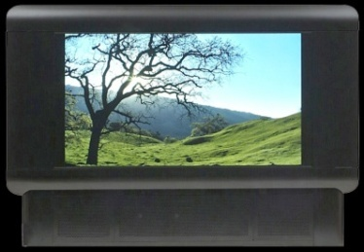
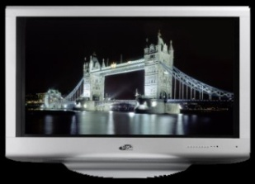
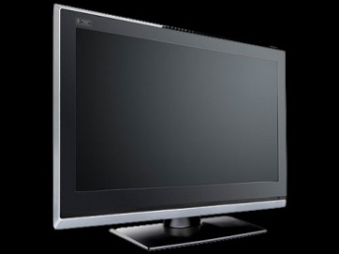
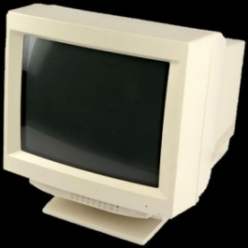
Advances in Display Technology
2nd HDR
1st HDR
LCD
CRT
Notes:
Display technology has been quickly advancing from CRT to HDR displays.
As a result, the peak luminance level of displays has significantly increased; and is now close to real-world luminance levels. <pause>

Slide 3
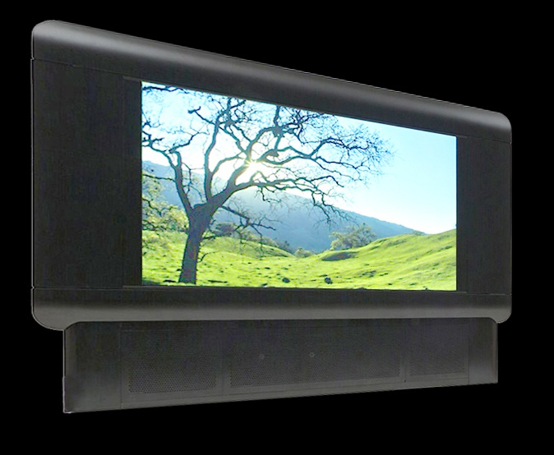
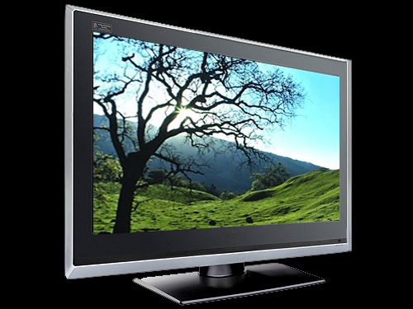
Luminance Impacts Color Perception?
≠
Low-luminance
display
High-luminance
display
⇨ New Color Appearance Model
Notes:
The question is:
Does such a significant increase in luminance influence our color perception?
>>>
If we display an identical image on a low-luminance and a high-luminance display,
Do they appear similar?
>>>
As it turns out, they do appear quite differently.
>>>
Our goal is to quantify this difference and to develop a so-called color appearance model that can predict how colors are perceived under a wide range of luminance levels. <pause>

Slide 4
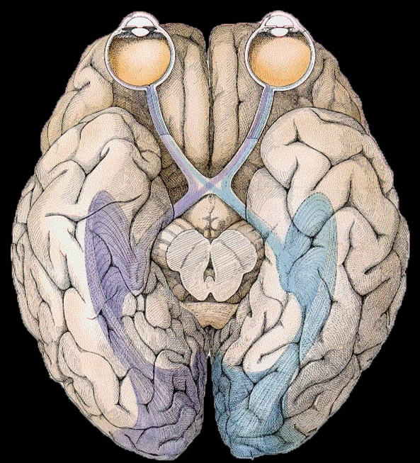
Human Eye
Color is a perceptual, not a physical quantity
Visible spectrum
[Müller 1930]
Fovea
Zone 1
L
M
S
R
Retina
(40:20:1)
L
M
S
R
Zone 2
A
_{R-G}
_{Y-B}
A
_{R-G}
_{Y-B}
Ganglion
Zone 3
Visual Cortex
Color Appearance
Attributes
Color Appearance
Attributes
Lightness,
Colorfulness,
Hue, …
Notes:
Color is a perceptual quantity, which is triggered by /f/ysical stimuli.
>>>
Based on Muller’s Zone theory, the visible spectrum is sensed by our retina, which contains long-, middle-, and short-cones for color, and rods for dark vision.
>>>
Neurons transform these signals into achromatic signals and color opponent signals,
which are then sent to the visual cortex.
>>>
There, they are interpreted as color appearance attributes; for instance, lightness, colorfulness, and hue.
>>>
We want to find a computational model that predicts these perceptual appearance attributes. <pause>

Slide 5
Lightness
Lightness ≈
60% bright
Reference white
Notes:
Since we will frequently use these three color attributes, we briefly describe them.
What is lightness?
>>>
Suppose we have a patch, which appears to be white - let’s call it reference white.
>>>
It is possible to say that the left patch is about 60% as bright as the reference white.
This relative intensity is called “lightness”. <pause>

Slide 6
Colorfulness
Colorfulness ≈
3 times greener
Compared to
Notes:
What about colorfulness?
>>>
If we compare the left patch with the right,
The patch on the left can be said to be about 3 times greener compared to the patch on the right.
This variation is called “colorfulness”. <pause>

Slide 7
Hue
Perceptual Quantities
Hue ≈ 60% Green + 40% Blue
Notes:
Here is a patch.
>>>
It looks similar to the green and blue primary colors.
>>>
We can say that it appears to be 60% green and 40% blue.
This proportion of the two primary colors is called “hue”.
>>>
Note that these quantities are perceptual, in contrast, for instance, to the HSV color space. <pause>

Slide 8
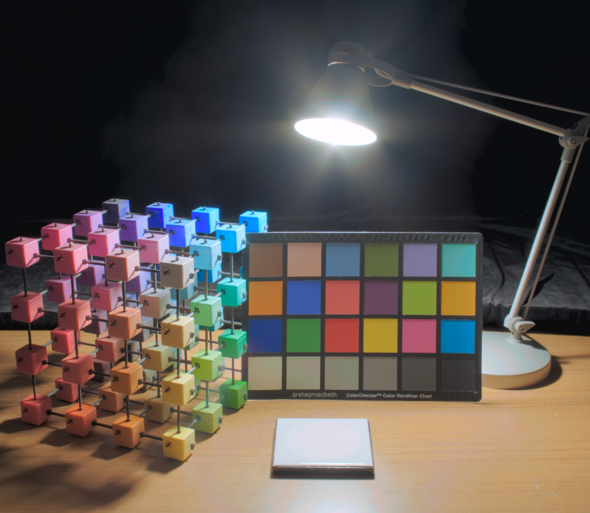
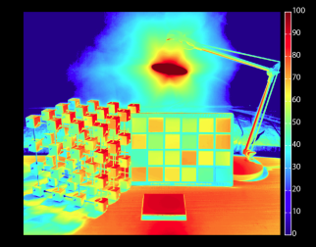
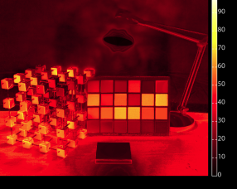
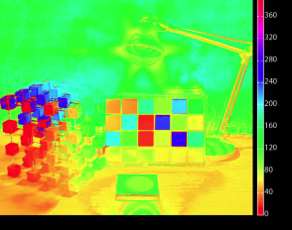
Color Appearance Model
Viewing Conditions
Color
Appearance
Model
Medium
Type
Luminance
Adaptation
Reference White
ReferenceWhite
Luminance
Adaptation
Medium
Type
Calibrated image
(e.g., CIEXYZ)
Lightness
Colorfulness
Hue
...
Perceptual
uniform
Notes:
So what is a color appearance model?
>>>
The color appearance model predicts the human perception of /f/ysical stimuli, for instance given as a calibrated CIEXYZ image, for specific viewing conditions.
>>>
These include the reference white point (/that is/(i.e.), the brightest point in the scene),
>>>
the luminance adaptation level of our eye (for which we use the average amount of incident light),
>>>
the medium type (like an HDR display, or paper), and so on.
>>>
The outputs of the color appearance model are perceptually uniform color attributes such as lightness, colorfulness, hue, et cetera… <pause>

Slide 9


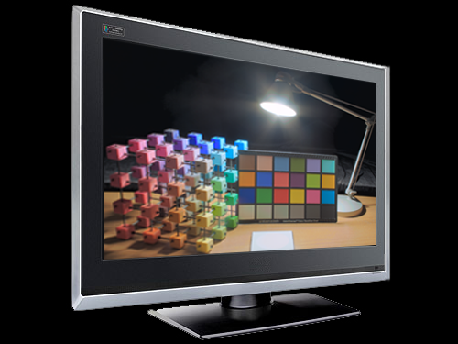
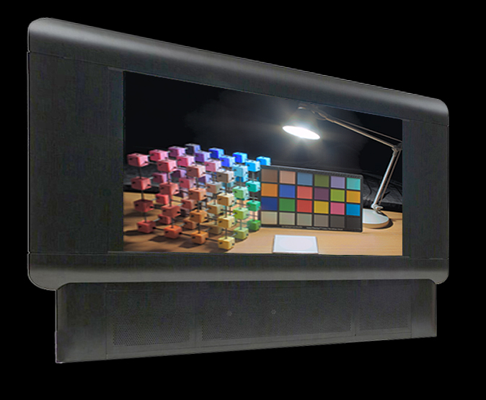
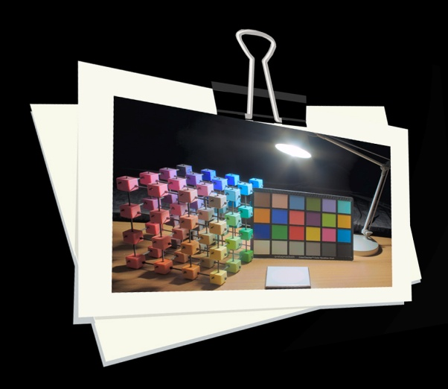
Color Appearance Model
Perceptual
Color Attributes
New Viewing
Conditions
Medium
Type
Luminance
Adaptation
Reference White
Medium
Type
Luminance
Adaptation
Reference White
Inverse Color
Appearance
Model
High Fidelity
≈
≈
LDR display
HDR display
Print
Notes:
Once we have the perceptual color attributes of an image,
>>>
the inverse color appearance model can be used to create perceptually equivalent reproductions across different media
>>>
by taking into account the new output viewing conditions. <pause>

Slide 10
Color Appearance Models
CIELAB
RLAB
LLAB
CIECAM97s
Hunt94
model
Fairchild
model
FC model
CIECAM02
Limited range of luminance
CIELAB
CIECAM02
Notes:
Color appearance modeling has been research/t/ for quite a long time and there are many different models.
>>>
For example, the well-known CIELAB color space.
>>>
As well the international standard CIECAM02.
>>>
However, as we will see, all of these models work well only for a limited range of luminance. <pause>

Slide 11
LUTCHI Experiments
Psychophysical measurements for color appearance
Most of the models mainly derived from this dataset
[Luo et al. 1991]
30cd/m²
Reflective
(Low)
Reflective
(High)
CRT display
35mm projection
Textile
Reflective
(Various)
BIT
Cut-sheet
101cd/m²
182cd/m²
Under
~690cd/m²
387cd/m²
607cd/m²
29cd/m²
~690cd/m²
(only four samples 1,000~1,280cd/m²)
97cd/m²
Notes:
In order to derive a color appearance model, we need psycho/f/ysical experimental data. No data, no models.
The seminal LUTCHI experiments produced the largest dataset of psycho/f/ysical measurements of color appearance available.
Most color appearance models are derived from this dataset.
>>>
The LUTCHI experiments include a large variety of media, from reflective materials to CRT monitors.
>>>
However, most of the data is under a luminance of 690 candelas per square meter, which corresponds to the available display technology in the 90s.
>>>
This means there is no available perceptual dataset for high luminance levels.
Consequently, the previous color appearance models are also limited to that range. <pause>

Slide 12
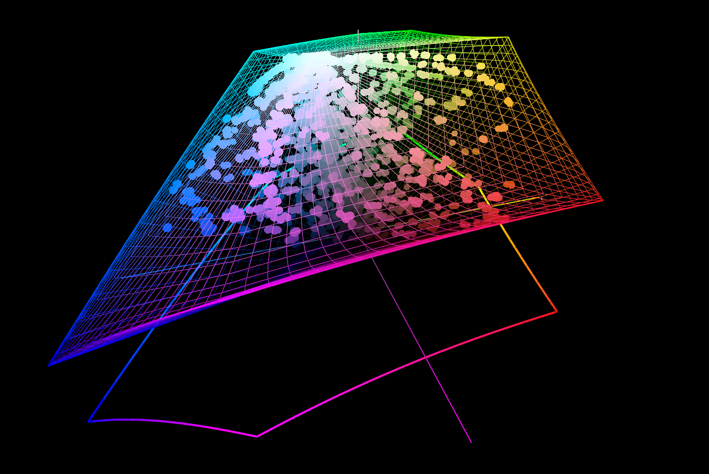
Goal
Color appearance model for extended luminances
  Covering most of the range of the human visual system
  (photopic range: >= 10cd/m²)
Notes:
Hence, our goal is to develop a color appearance model for extended luminance levels,
which covers most of the luminance range of the human visual system. <pause>

Slide 13
Contribution
High-Luminance
Experiments
Evidence that absolute
luminance matters
High-Luminance
Experiments
Evidence that absolute
luminance matters
Fit & Analysis
New data
Fit & Analysis
New data
New Color
Appearance Model
For large
luminance range
New Color
Appearance Model
For large
luminance range
Applications
Cross-media
color reproduction
Applications
Cross-media
color reproduction
Notes:
Our contributions are:
>>>
A psycho/f/ysical experiment for high luminances,
which evidences that absolute luminance matters in color appearance.
>>>
Through an analysis of our new data,
>>>
We provide a new color appearance model, which captures color appearance under a large luminance range.
>>>
And finally, we demonstrate applications for high-fidelity cross-media color reproduction. <pause>

Slide 14
Overview
Experiment
- Building an high-luminance display
- Psychophysical experiments
- Initial findings
Color Appearance Model
HDR Color Reproduction
Notes:
We will first present our experiment. <pause>

Slide 15
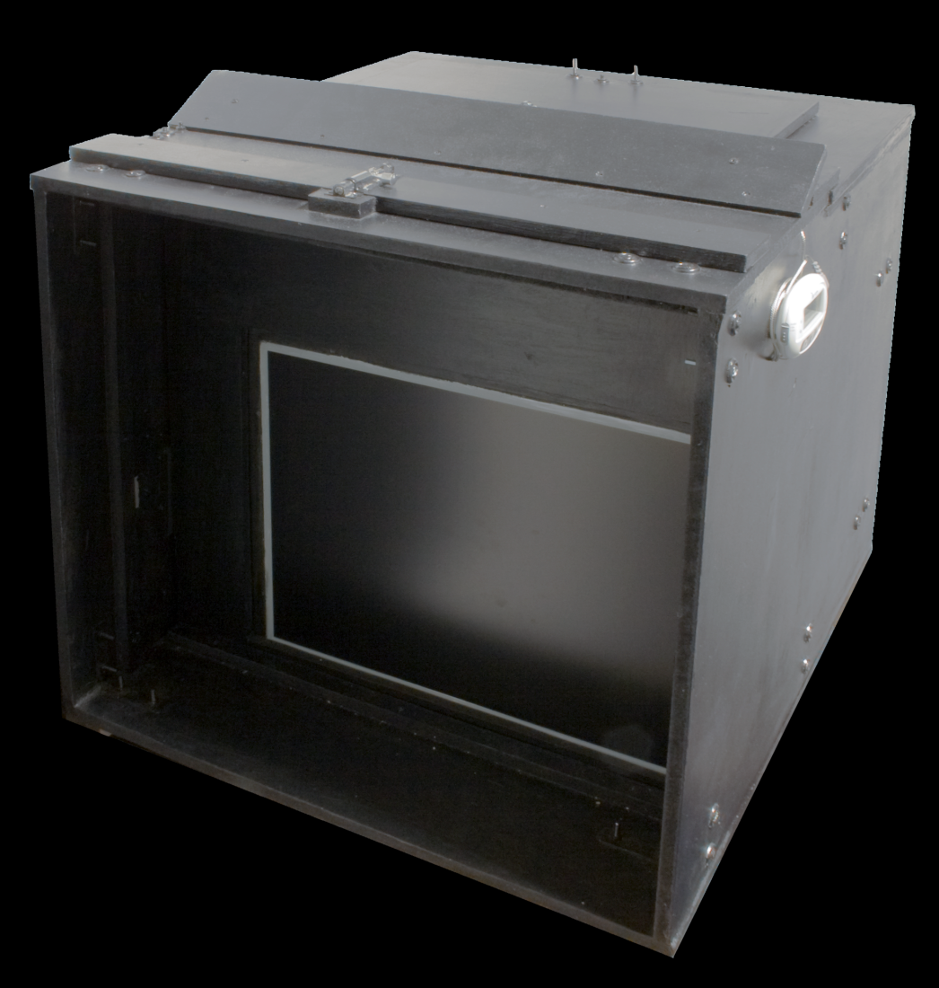
High-Luminance Display
We require
  Controllable high-luminance viewing environment
  Photopic luminance range
Available HDR display
  ≤ 4,000cd/m² [Dolby 2008]
Do not require
  High contrast resolution
  Max. 16,860cd/m²
Notes:
For the experiments, we need to have a controllable high-luminance viewing environment,
which covers the /f/otopic luminance range of about 5 orders of magnitude.
>>>
Unfortunately, current displays cannot reach that magnitude.
Even current HDR displays only yield 4,000 candelas per square meter.
>>>
Hence, we built a new display device that produces a maximum of 16,000 candelas per square meter,
which corresponds to white paper in noon sunlight.
>>>
Note that unlike HDR displays, we don’t need high contrast resolution as we choose a selection of specific colors for our psycho/f/ysical experiments. <pause>

Slide 16
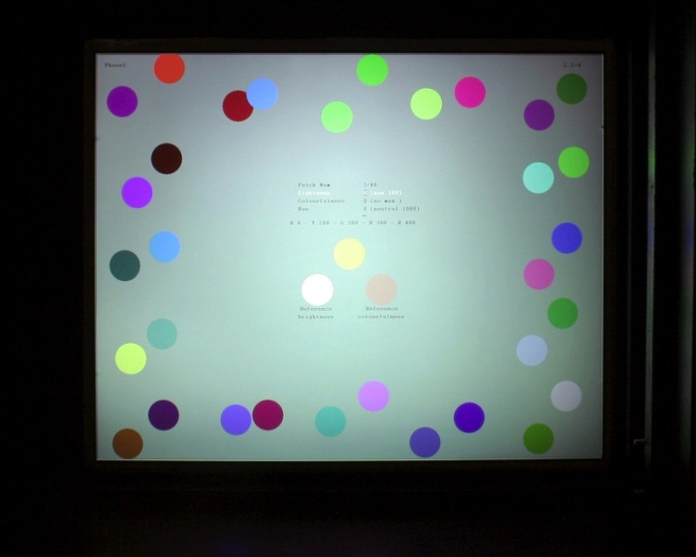
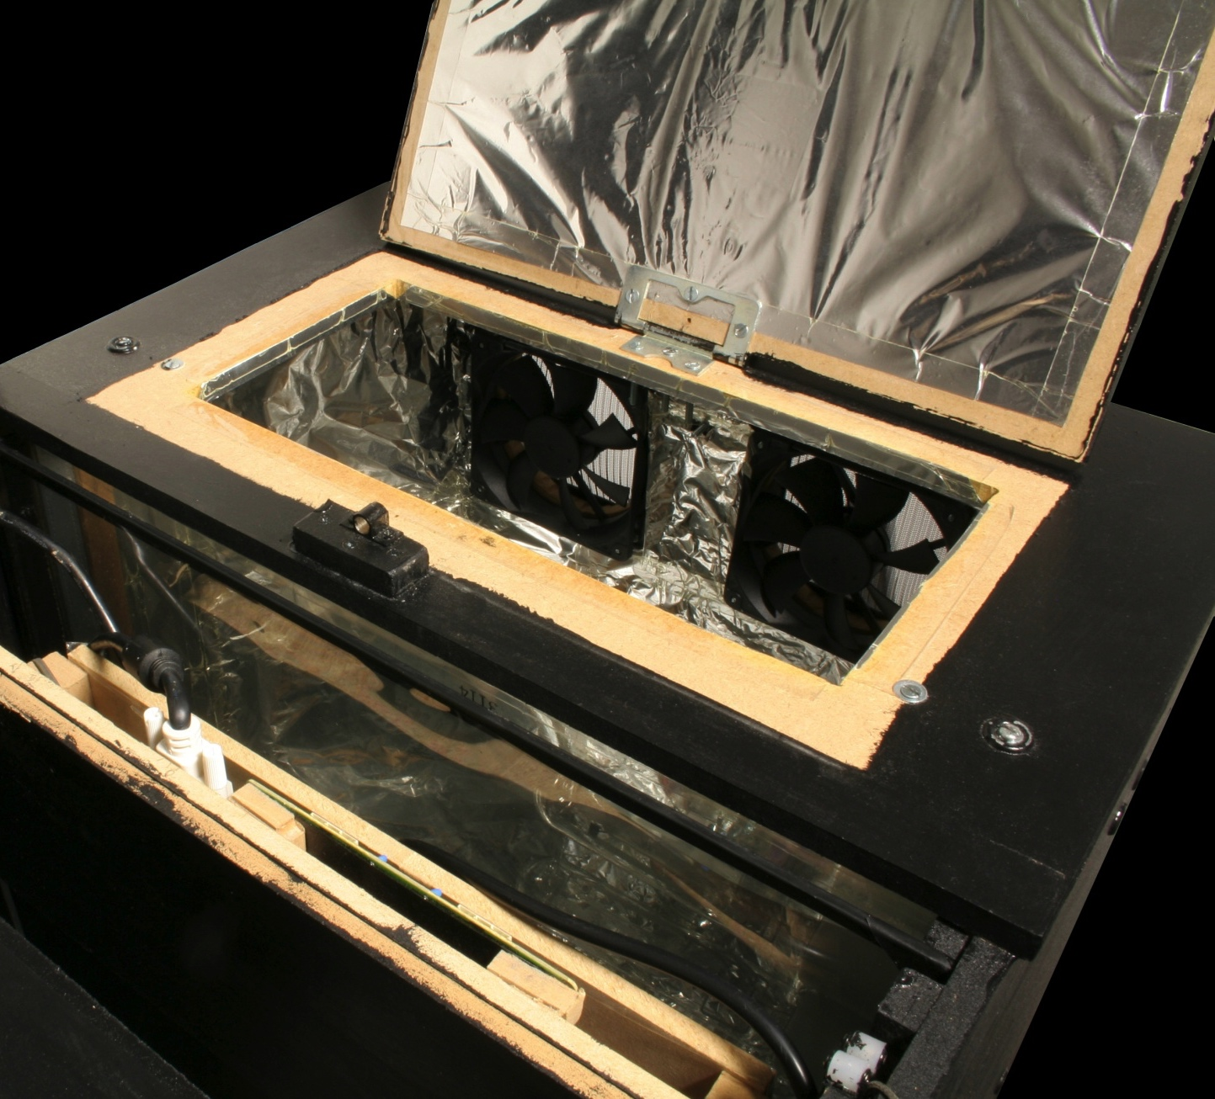
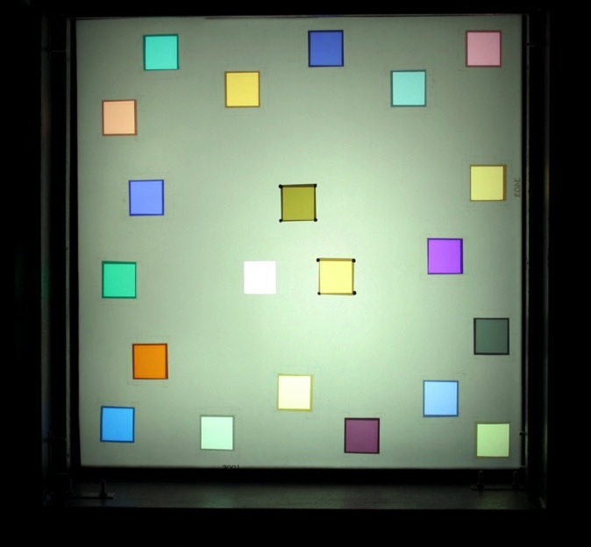
High-Luminance Display
HMI Bulbs 400W (X2)
UV Filter & Fire Glass
LCD Panel
(≤ 2,241cd/m²)
Neutral Density & Color Control Filter
LCD or Transparencies
Transparencies
(≤ 16,860cd/m²)
Notes:
This picture shows the inside of our display device.
>>>
Here are two 400W HMI bulbs in front of the fans.
>>>
Then, an ultra-violet filter and fire glass are installed to protect the LCD panel against heat.
>>>
This slot is for the neutral density filter and color control filters.
>>>
Here we can slot in an LCD panel or transparencies.
>>>
These are /f/otogra/f/s of the LCD panel and the transparencies, with which the maximum luminance goes up to 16,000 candelas per square meter. <pause>

Slide 17



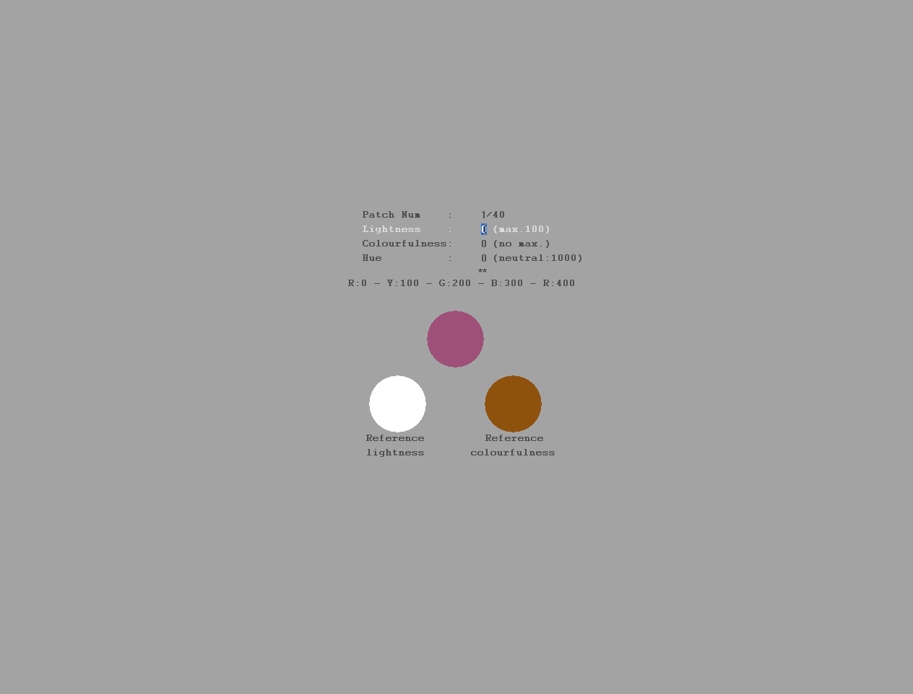
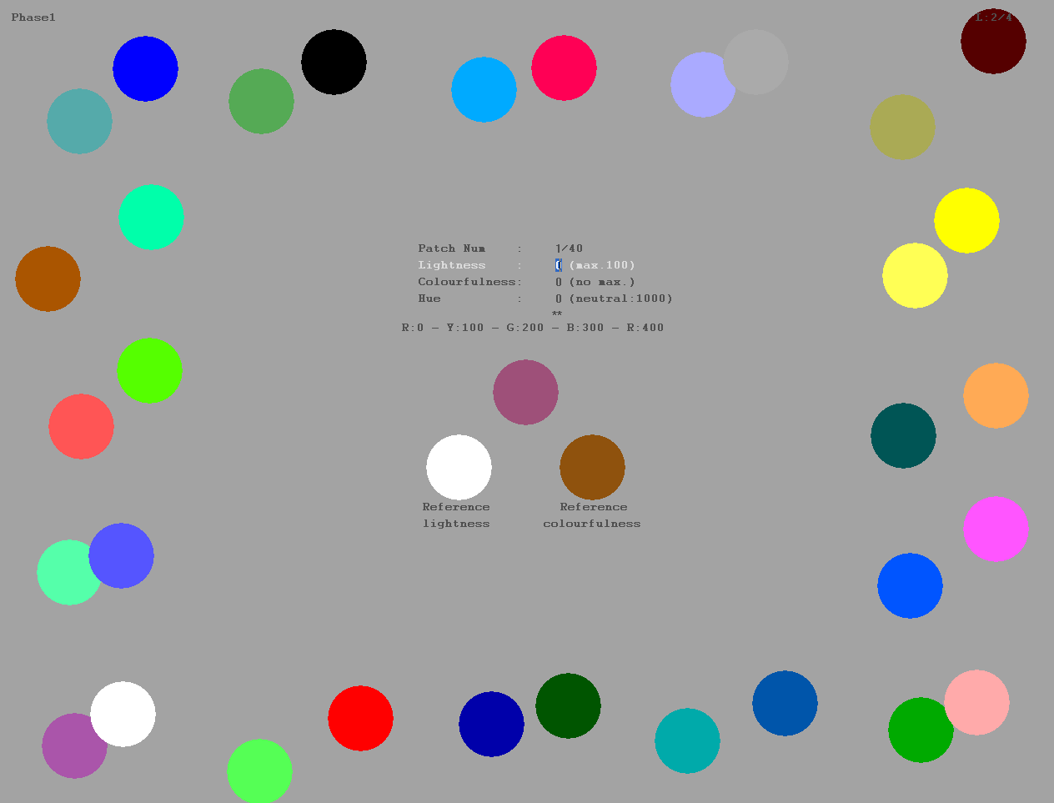
Enter Numbers Here
Color Sample
Reference
White
Reference
Colorfulness
Notes:
This is our experiment with the high-luminance display, which largely follows the design of the LUTCHI experiment.
>>>
The color samples are displayed at the center with various luminances, backgrounds, color temperatures, and surrounds.
>>>
This is the reference white for lightness estimation, which is the brightest patch within the screen.
>>>
This is the reference colorfulness patch, which is used as an anchor point for the colorfulness estimation.
>>>
Here participants enter their magnitude estimations of lightness, colorfulness, and hue.
>>>
Also, we place 32 decorating colors around the screen to mimic a real-world viewing environment. <pause>

Slide 18
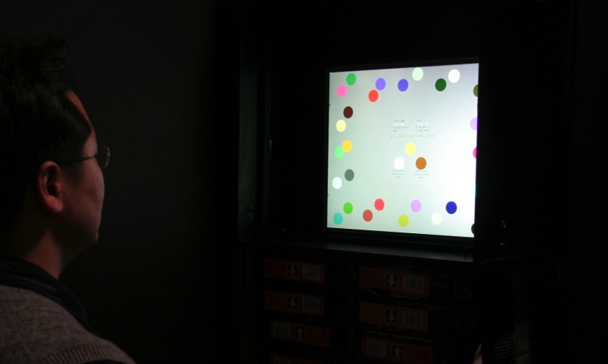
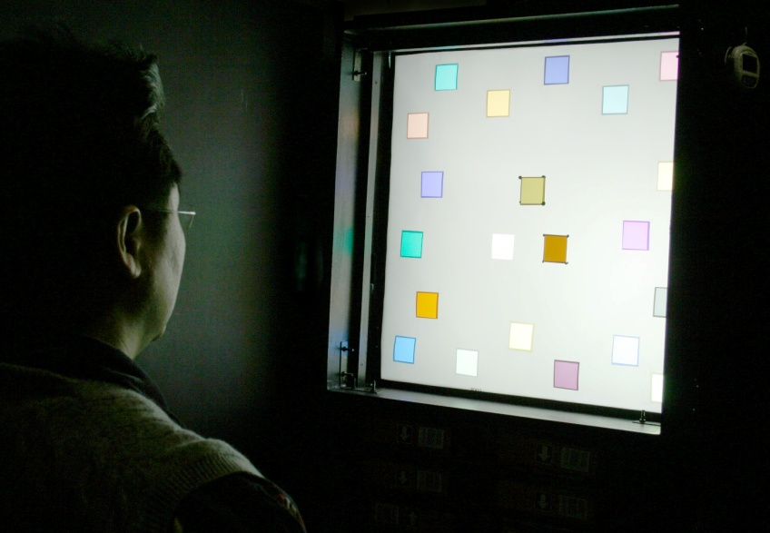
Experiment
19 phases – 40 colors each
Variations of viewing conditions:
  luminance level (≤16,860cd/m²),
  background level, ambient luminance, and color temperature
Six trained color-normal expert observers (10h)
LCD Panel
Transparency
Notes:
These are /f/otogra/f/s of the experimental settings with the LCD panel and transparency screen, respectively.
>>>
There were 19 different /f/ases, where 40 color patches were judged in each /f/ase.
For each /f/ase, we varied the peak luminance level, backgrounds grey level, ambient luminance, and color temperature of the light source.
We employed six trained color-normal expert observers.
The experiments took about 10 hours per person without counting break times. <pause>

Slide 19
Findings
Luminance dependency (Stevens & Hunt effect)
  Higher Luminance → higher lightness & colorfulness
Background dependency (Simultaneous Contrast)
  Brighter Background → lower lightness & colorfulness
Qualitative comparisons
Notes:
These are our initial findings:
If the luminance level increases, then, lightness and colourfulness both increase,
which confirms the so-called ‘Stevens’ and ‘Hunt Effect’.
>>>
In contrast, if the background luminance level increases, lightness and colourfulness both decrease,
confirming the ‘simultaneous contrast effect’.
>>>
Let me show you an example of perceptual trends of lightness and colourfulness against /f/ysical measurements.
The left figure shows lightness perception trends, and the right figure shows colourfulness perception trends of 40 different colour patches.
>>>
As you can see, the perception of high luminance lightness and colourfulness (the red dots) is obviously higher
>>>
than for low luminances (the blue dots).
Our dataset quantifies these /f/enomena under a large range of luminance levels. <pause>

Slide 20
Overview
Experiment
Color Appearance Model
- Cone response
- Color Appearance Attributes
- Results/Comparisons
HDR Color Reproduction
Notes:
We will now explain our color appearance model. <pause>

Slide 21
Our Color Appearance Model
Based on Zone Theory
[Müller 1930]
Input viewing conditions:
Chromatic Adaptation:
adapting to reference white
Visible spectrum
CMF
[Judd & Vos 1978]
X_{w}
X_{w}
X_{w}
X_{w}
Y_{w}
Y_{w}
Y_{w}
Y_{w}
Z_{w}
Z_{w}
Z_{w}
Z_{w}
L_{a}
L_{a}
L_{a}
L_{a}
Md
Md
Md
Md
X
Y
Z
Absolute CIEXYZ
CIECAT02
Transform
Chromatic Adaptation
Notes:
Our model is based on Muller’s Zone theory.
>>>
However, contrary to other color appearance models, we use absolute CIEXYZ as our input stimuli,
as we believe that absolute scale is very important to model luminance dependency.
>>>
Our input viewing conditions are defined by the reference white, the luminance adaptation level, and the medium type.
>>>
First, our model adapts to the white point of the scene, with respect to the reference white.

Slide 22
Our Color Appearance Model
L/M/S cones space
(HPE Transform) [Estevez 1979]
Dynamic cone response with adaptation level σ:
[Velenton and Norren 1983]
Weighted L’/M’/S’ → achromatic A
[Vos and Walraven 1971]
Inverse CIECAT02 &
HPE Transform
Fovea
Zone 1
L
M
S
Retina
← Dynamic L_{a}
L’
M’
S’
Notes:
Then the signals are transformed into the LMS cone color space.
>>>
The cone response in our model is compressed by a sigmoidal function; the constant n of which is derived from our experimental data.
>>>
However, contrary to other color appearance models, we use a dynamic sigma parameter, which is based on the luminance adaptation level, following the original /f/ysiological finding by Velenton and Norren.
>>>
An weighted average of these non-linear cone responses yields the achromatic signal A.

Slide 23
Our Color Appearance Model
Inverse sigmoidal of A
→ Lightness (J)
Colorfulness (M) ≈
magnitude(a, b) * L_{w}
Hue (h) ≈ atan2(a, b)
Output:
Lightness (J), Colorfulness (M),
Hue (h), …
A
_{R-G}
_{Y-B}
Zone 2
Neuron
a
a
b
b
Zone 3
Visual
Cortex
J
M
h
Color Appearance Attributes
(J, M, h, s, Q, C, H, ac, bc)
Notes:
After that, the achromatic signals and color opponent signals a & b are transformed into color appearance attributes.
>>>
In contrast to other color appearance models, we use an inverse sigmoidal function to transform achromatic signals A to ‘lightness’ perception values J,
which provides a much more accurate prediction of lightness.
>>>
Colorfulness is calculated from the magnitude of the color opponent signals, scaled by a luminance-dependent factor Lw.
>>>
The hue angle h is derived by converting a and b into polar coordinates.
>>>
Once we have the lightness, colorfulness, and hue,
we can also calculate other derivative color attributes, such as brightness, chroma, and so on.
All the constants of our model are optimized through an exhaustive search, based on our experimental as well as the LUTCHI data. <pause>

Slide 24
Results
Lightness and
colorfulness prediction significantly better than others.
Hue performs comparably to others
CV = RMS / Mean
(lower = better)
Notes:
We evaluate our model using the coefficient of variation (CV), that is, the RMS error with respect to the mean
as commonly used for the evaluation of color appearance models.
>>>
These gra/f/s show the accuracy performance in CV error, compared with CIELAB, RLAB, and CIECAM02 models for all /f/ases
>>>
As shown on the first two plots, lightness and colorfulness predictions of our model are significantly better than the previous models.
>>>
Hue predictions are almost the same among all these models. <pause><pause>

Slide 25
Results
CV errors (LUTCHI data)
  CRT monitor, reflective paper, and transparency sheet
Notes:
This gra/f/ depicts the averaged prediction error of the same four models on the LUTCHI dataset for CRT, paper, and transparency media.
>>>
Even on this dataset, our model performs better than the others in terms of lightness, colorfulness, and hue. <pause><pause>

Slide 26
Results
CIECAM02 vs. our model
  CIECAM02 lightness estimates form a curve off the diagonal
  Lightness and colorfulness prediction of our model are close to the diagonal (perception ≈ prediction)
  Both hue estimates are almost identical
Notes:
Here we compare CIECAM02 in detail with our model.
The plots show perceived color attributes of 40 patches against predicted color attributes.
If you look at the left plot,
>>>
CIECAM02 lightness predictions form a curve off from the diagonal for high luminances,
>>>
In contrast, our model’s lightness and colorfulness values are closer to the diagonal, which means our predictions are much closer to the actual perception.
>>>
As before, both hue estimates are almost identical. <pause><pause>

Slide 27
Overview
Experiment
Color Appearance Model
Applications
- Predict Visual Phenomena
- HDR Color Reproduction
Notes:
Next, we will demonstrate applications of our color appearance model. <pause>

Slide 28
Color Reproduction
Analytical inverse model
  Given perceptual attributes
  Given output device & viewing conditions
  Derive device signals
Output viewing conditions:
Perceptual match on target medium → high fidelity
(e.g. HDR tone mapping)
Color
Appearance
Attributes
J
M
h
Inverse Color
Appearance Model
X
Y
Z
CIEXYZ
X_{w}
X_{w}
X_{w}
X_{w}
Y_{w}
Y_{w}
Y_{w}
Y_{w}
Z_{w}
Z_{w}
Z_{w}
Z_{w}
L_{a}
L_{a}
L_{a}
L_{a}
Md
Md
Md
Md
Inverse Device
Characterization
R
G
B
Device
Signals
28
Notes:
Once we have the color appearance attributes as predicted by our model,
>>>
Our analytical inverse model enables the reproduction of the original color appearance under new output conditions.
>>>
The output viewing conditions for the inverse model are defined by the reference white, the luminance adaptation level, and the medium type, just as in the forward model.
>>>
The application of the inverse model, yields /f/ysically meaningful CIEXYZ values,
>>>
which we convert to actual output device signals.
>>>
This achieves a perceptual match of the original perceived input on a different output medium.
For example, this can be used to display HDR images on an LDR display, implicitly performing tone-mapping. <pause>

Slide 29
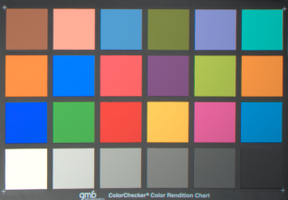
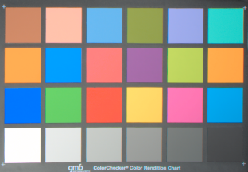
Results
Predict color appearance phenomena
  Stevens effect, Hunt effect, and simultaneous contrast
Notes:
As mentioned earlier, our color appearance model can be used to predict “color appearance /f/enomena”
such as the ‘Stevens-’, ‘Hunt-’, or ‘simultaneous contrast’ effect.
Here is an example of the simultaneous contrast effect,
These two color charts are reproduced to have matching color appearances given the two different backgrounds.
Even though they appear the same,
>>>
when they share a common background, we can see that they are actually different. <pause>

Slide 30
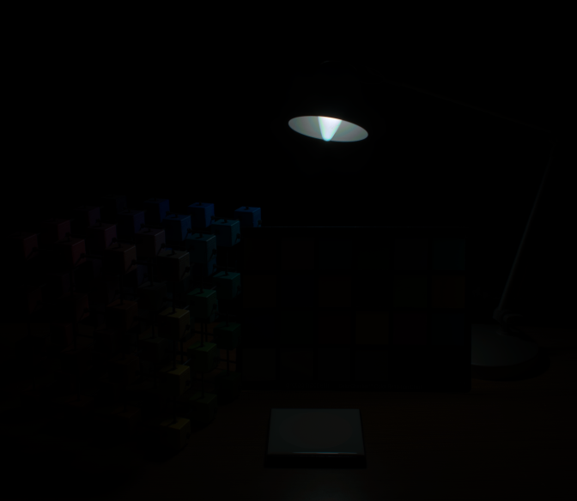
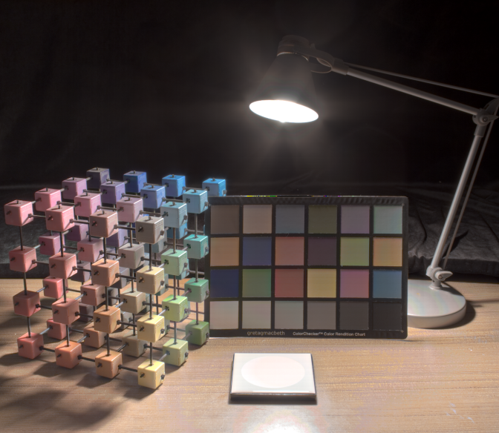
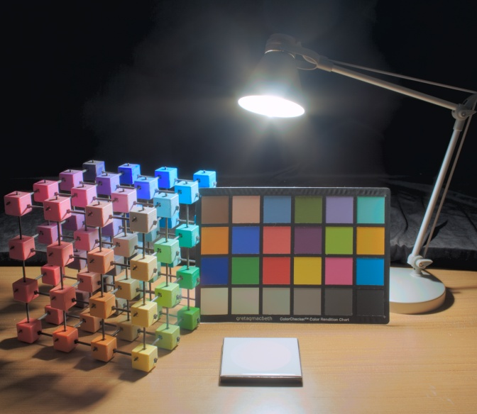
Results
Classical color appearance model fails with HDR images
Our global model outperforms spatially varying image appearance model [Kuang et al. 2007]
CIECAM02
iCAM06
Our Model
Notes:
Let me now demonstrate the tone-mapping of HDR images.
>>>
As shown in the left figure, the classical color appearance model, CIECAM02, fails with HDR images, because the images contain very high luminance levels.
>>>
The middle figure shows a recent spatially-varying image appearance model, called iCAM06.
>>>
The right figure uses our color appearance model, which provides good color reproduction that is very close to human perception. <pause><pause>

Slide 31
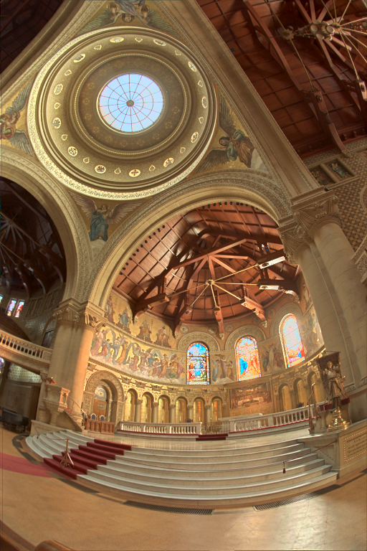
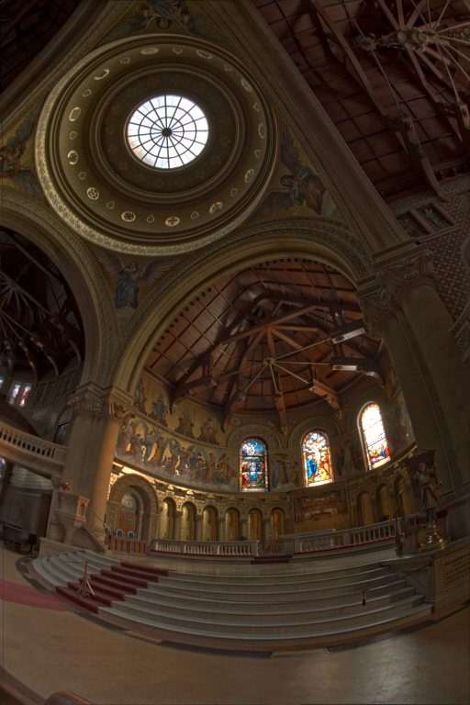
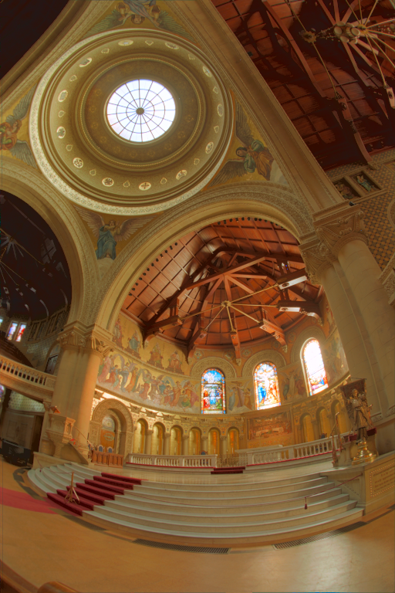
Results
Our model outperforms spatially varying HDR tone-mapping and image appearance model
Reinhard et al. 2002
iCAM06
Our Model
Notes:
Here is another comparison with the spatially varying HDR tone-mapping algorithm by Reinhard et al. and iCAM06.
Our model compresses luminances of HDR images well for cross-media color reproduction. <pause><pause>

Slide 32
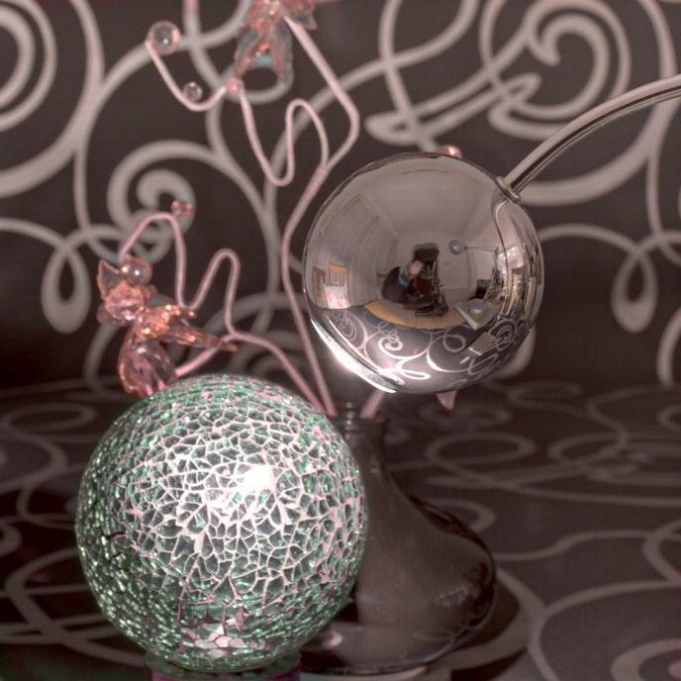
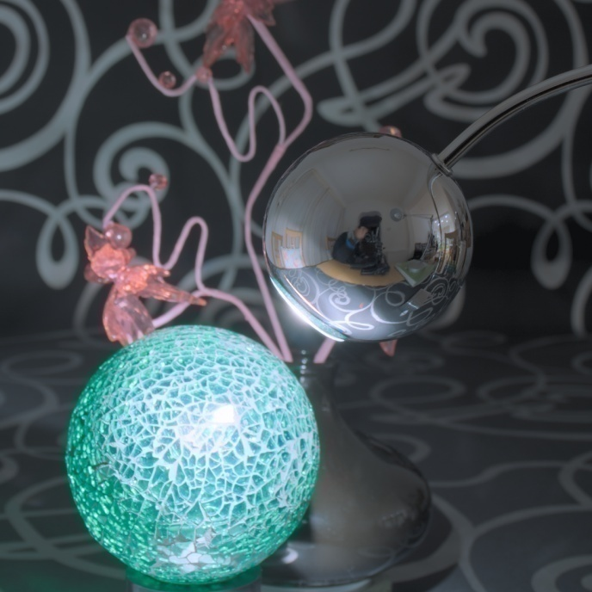
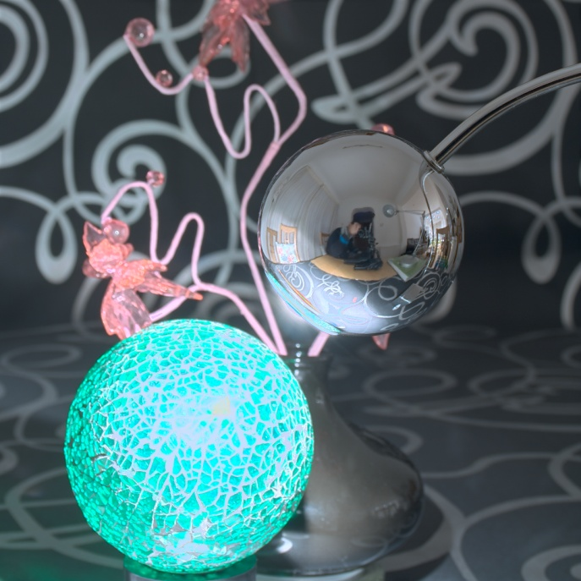
Results
Preserve not only tone, but also colorfulness
Reinhard et al. 2002
iCAM06
Our Model
Notes:
If you look at the green glass ball in the figures, you can see that our model not only performs tone mapping, but also preserves the colorfulness of the original scene. <pause><pause>

Slide 33
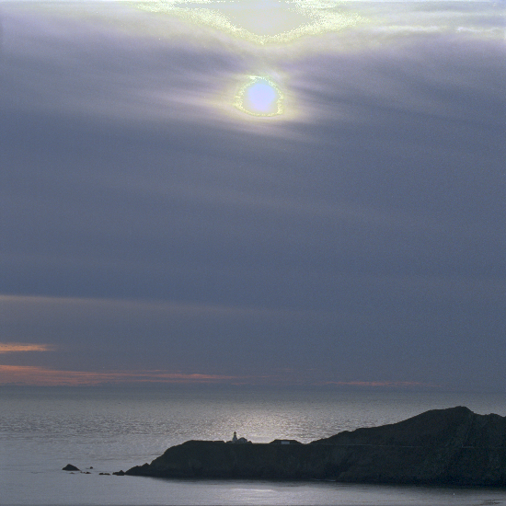
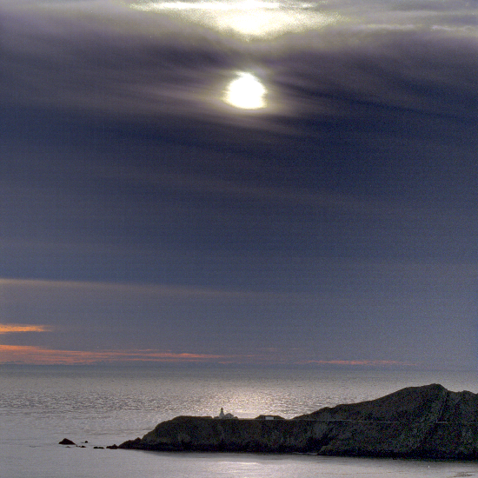
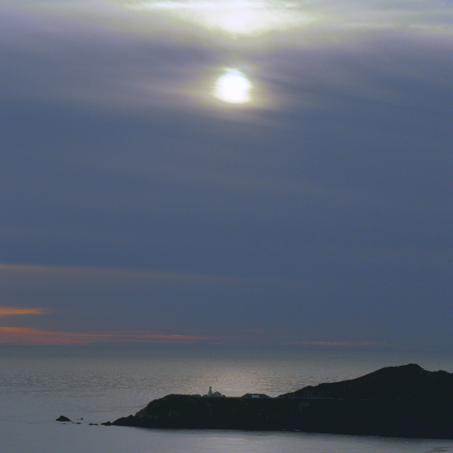
Results
No artifact of spatial adaptation, e.g., halos or banding
Reinhard et al. 2002
iCAM06
Our Model
Notes:
Since our model doesn’t use any spatially varying adaptation, it doesn’t suffer from halo artifacts. Yet, it offers very good luminance compression which is on-par with spatially varying models. <pause><pause>

Slide 34
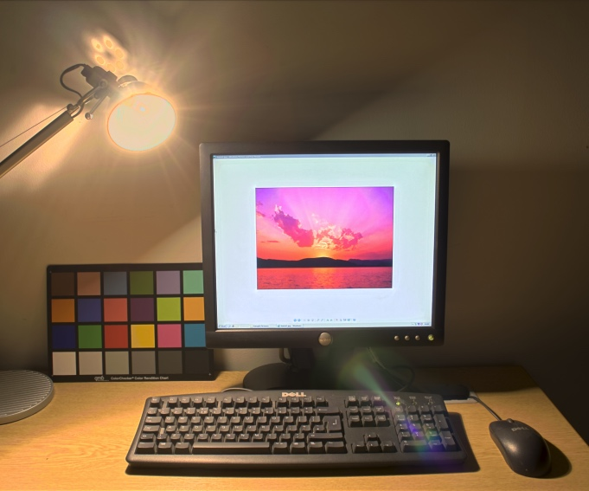
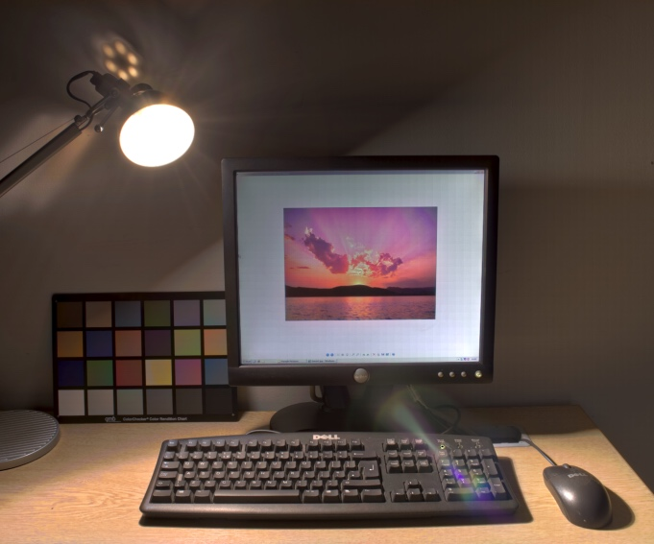
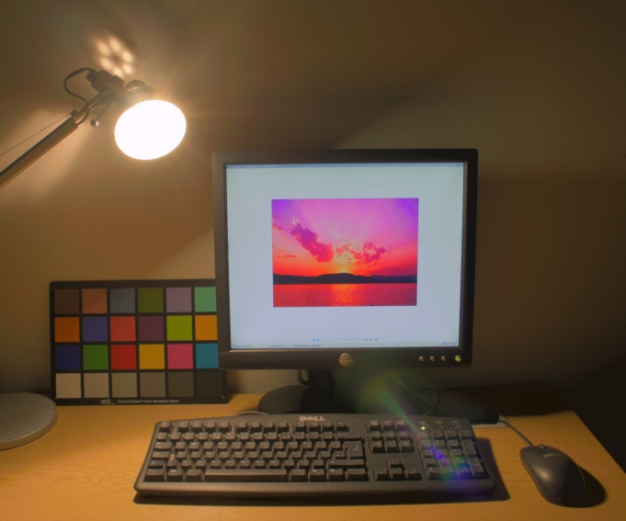
Results
Pilot study to evaluate reproduction performance
  10 participants consistently ranked it most similar to reality
Reinhard et al. 2002
iCAM06
Our Model
Notes:
We also carried out a pilot study to evaluate reproduction performance. 10 participants consistently ranked our model performance as most similar to reality, compared to the previous models. <pause><pause>

Slide 35
Discussion
Photopic vision only
  Targeting extended luminance levels
Our luminance adaptation
  Implicitly includes background and surround luminance
Need absolute CIEXYZ images
  Requires HDR characterization [Kim and Kautz 2008]
Gamut mapping
  Not explicitly handled
Notes:
As discussed before, our model covers /f/otopic vision only, targeting extended luminance levels.
>>>
Our model implicitly supports different background and surround luminance levels through the luminance adaptation level parameter.
As a result, our model does not have separate parameters for background and surround.
>>>
As input, our model requires /f/ysically meaningful, absolute CIEXYZ coordinates, which can be obtained through HDR characterization.
>>>
Also note that gamut mapping is not explicitly handled in this project. <pause>

Slide 36
Conclusions
High-luminance color experiments
  Evidence that high luminance matters
A new color appearance model
  Predicts color perception according to new data
Demonstrate our model
  Cross-media color reproduction
Notes:
In conclusion, we conducted high-luminance color experiments, which show that luminance matters for lightness and colorfulness perception.
>>>
We developed a new color appearance model, which predicts human perception according to the newly acquired experimental data.
>>>
Furthermore, we have demonstrated our model for cross-media color reproduction of high-dynamic-range images. <pause>

Slide 37

Acknowledgements
Harsha Sri-Narayana, Andrew Cox, Jeren Chen,
Martin Parsley, James Tompkin, Prof. Zhaoping Li, and SIGGRAPH reviewers (random order)
  Project & Paper
Paul Debevec, Greg Ward, Dani Lischinski, Martin Cadik, Yuanzhen Li, and Industrial Light & Magic (random order)
  HDR Images for paper & presentation
Thank you very much!
Notes:
We would like to thank our colleagues and SIGGRAPH reviewers for their help on this project,
and other authors for HDR images.
>>>
Finally, thank you very much for your attention. <pause>

